Slide 1
WORLD HAPPINESS REPORT
Data Analytics — Stage 0
First Insights & Visual Thinking
Dataset: World Happiness Report 2015–2019 | Source: Kaggle / Gallup World Poll
🌍 158 Countries · 5 Years of Data · 6 Variables Analyzed

Slide 2
THE DATASET
SLIDE 2 OF 6
What is the World Happiness Report?
6 KEY VARIABLES
An annual Gallup World Poll measuring self-reported well-being across nations. Countries score 0–10 on a 'Cantril ladder' life evaluation, aggregated from thousands of interviews per country.
GDP per Capita
Social Support
Healthy Life Expectancy
📅
🌍
📊
🗄️
Freedom to Choose
Trust in Government
2015–2019
~158
0–10
782
Generosity
Years
Countries
Score Range
Total Records
First Glance: The dataset is clean and well-structured. Nordic nations cluster at the top consistently. Sub-Saharan Africa and war-torn nations score lowest. GDP, health, and social support are closely interlinked.

Slide 3
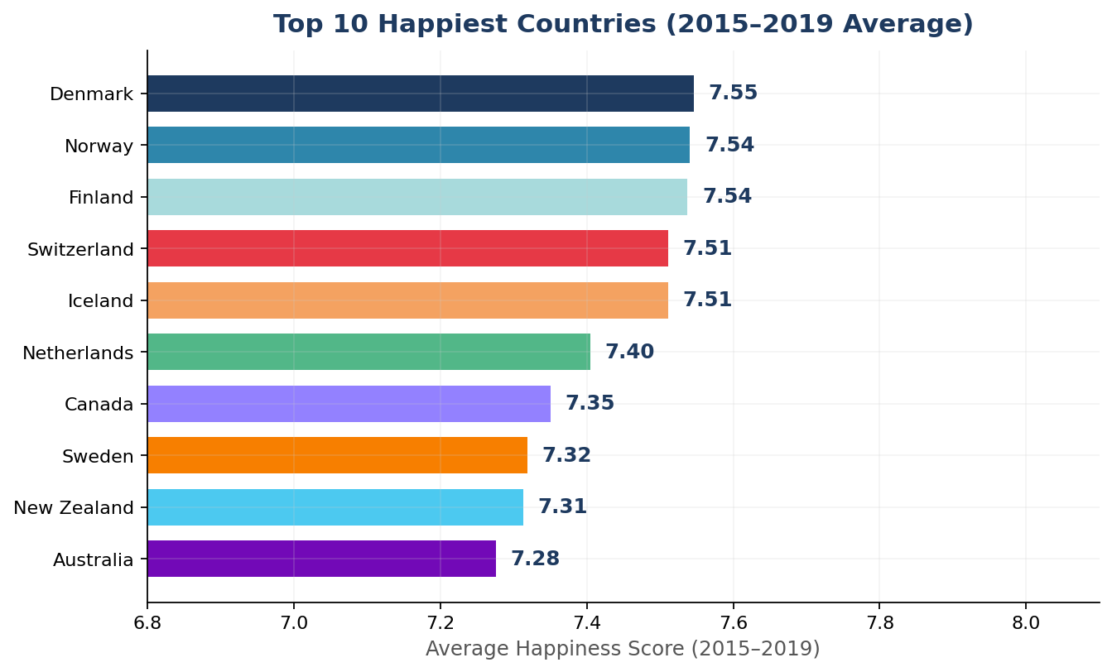
Q1: Which countries are consistently the happiest?
SLIDE 3 OF 6
KEY INSIGHTS
#1
Denmark leads with a 5-yr avg of 7.55 out of 10
🏔
All Top 10 are in W. Europe, Oceania or N. America
❄️
Nordic model: social safety nets + strong freedom
📉
Top 10 cluster tightly (7.28–7.55); competitive race

Slide 4
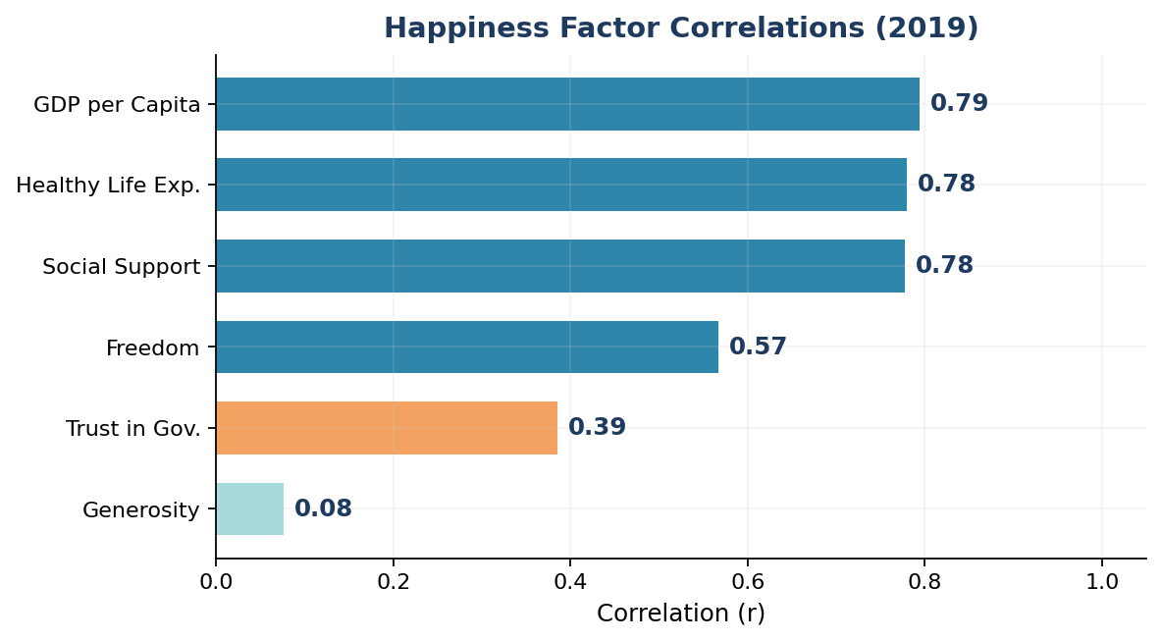
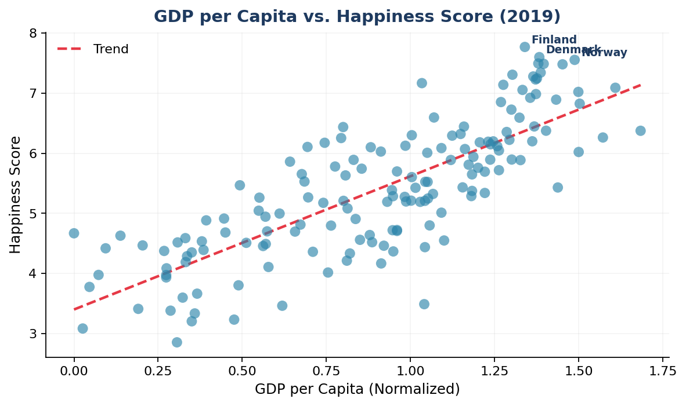
Q2: What factors most strongly drive happiness?
SLIDE 4 OF 6
Correlation with Happiness Score (2019)
GDP per Capita vs. Happiness (2019)
💰 GDP: r = 0.79
❤️ Health: r = 0.78
👥 Social: r = 0.78
🎁 Generosity: 0.08
Wealthiest nations are happiest — strongest single predictor.
Life expectancy and happiness are almost equally correlated.
Having people to rely on matters as much as income.
Weakest link — giving behavior doesn't predict national score.

Slide 5
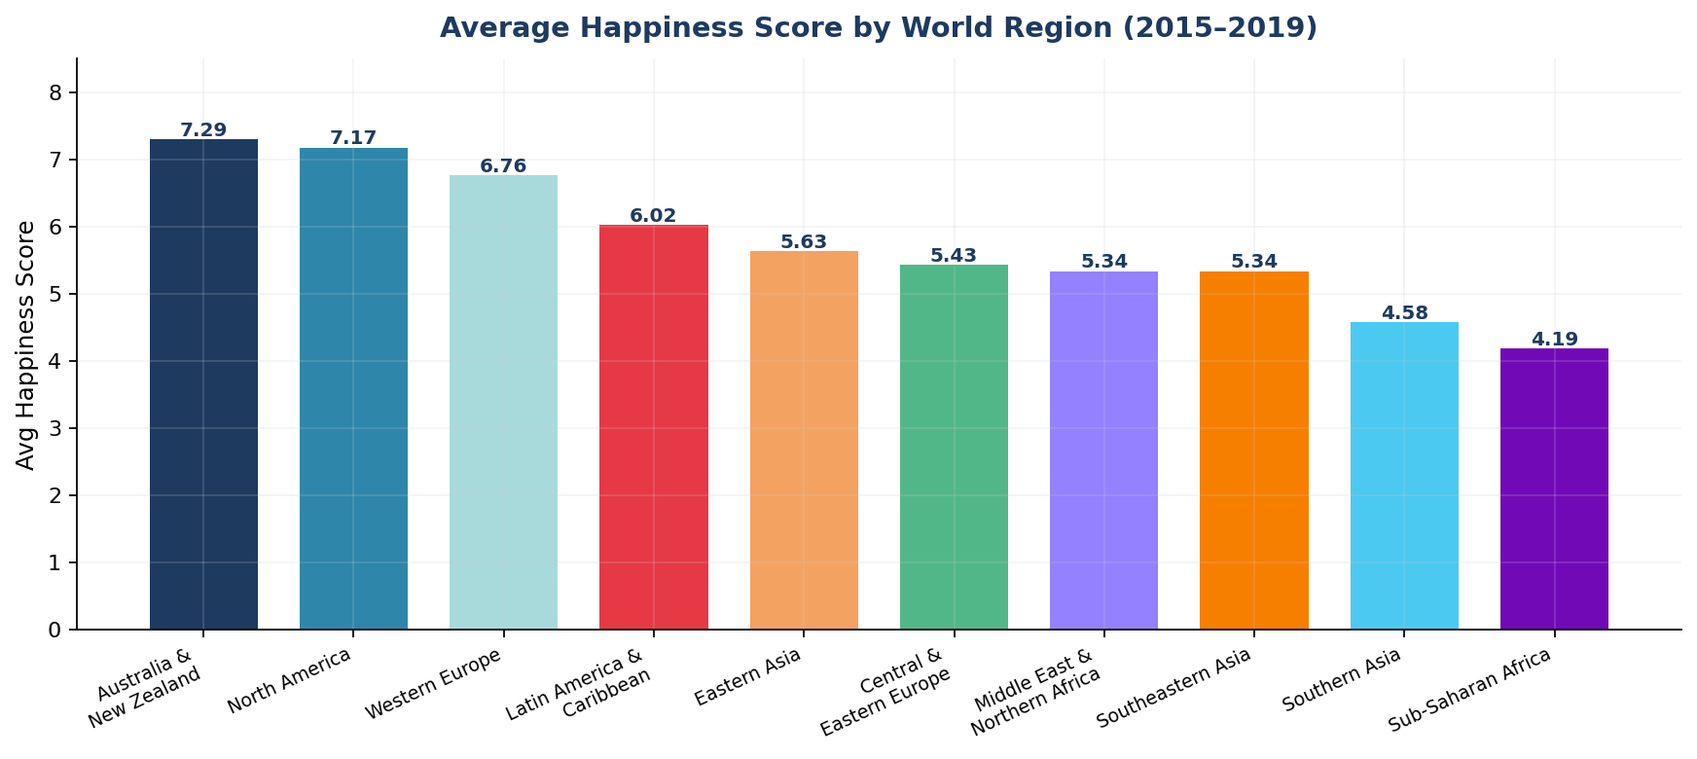
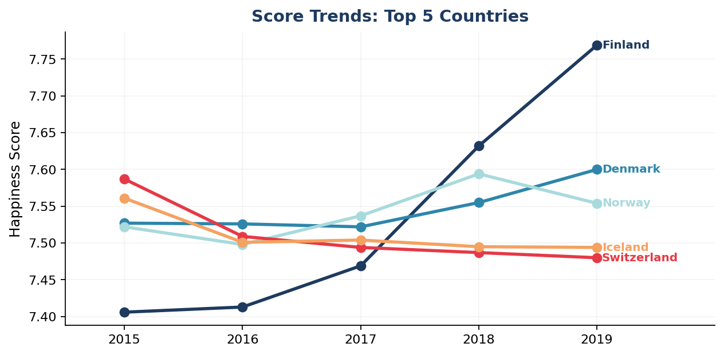
Q3: How does happiness vary by region and over time?
SLIDE 5 OF 6
Regional Average Scores (2015–2019)
Score Trends: Top 5 Nations
7.30
6.76
4.19
Oceania & N. Am.
W. Europe
Sub-Saharan Africa

Slide 6
KEY TAKEAWAYS & LIMITATIONS
01
Nordic nations lead the world
LIMITATIONS
Denmark, Norway, Finland & Iceland have held the top 5 consistently from 2015 to 2019.
Self-reported scores may carry cultural response bias
02
GDP + Health + Social = Happiness
Some regions have fewer countries, skewing averages
These 3 factors explain most of the variance in happiness (r > 0.77 each), far outpacing trust and generosity.
2017 data lacks region labels — mapped from 2015–16
03
A 4.47-point global divide exists
The happiness gap between richest and most deprived nations spans nearly half the entire 0–10 scale.
5-year window may miss longer economic policy cycles
04
Global scores are remarkably stable
Correlation ≠ causation: GDP links don't prove GDP causes happiness
Average global happiness shifted by less than 0.05 points in 5 years — systemic drivers, not events, shape happiness.
Analysis — World Happiness Report 2015–2019 | HNG Data Analytics Track — Stage 0 | #HNGDataAnalytics

